Slide 1
Asynchronous Android
Async tasks, Loaders, Services and more
Iurii Okhmat

Slide 2
Basics
Async Android

Slide 3
Android application
Process
Single process per application
Process name matches package name
Process name for application can be changed through AndroidManifest.xml
Activities and services can start in separate process (“:” for private, “lower-case” for public)
Threads
“Lightweight” processes
At least one thread per application (UI thread)
Communication and resource sharing issues

Slide 4
Multithreading
Asynchronous Android

Slide 5
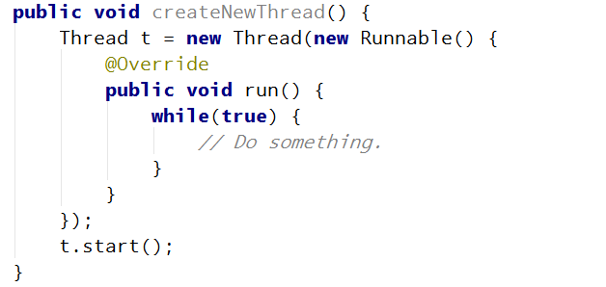
Thread
Basic “building block”
Two ways to implement thread: provide runnable or subclass Thread class (as Thread implements Runnable).
Must explicitly call “start” to run the thread
First approach is preferred

Slide 6
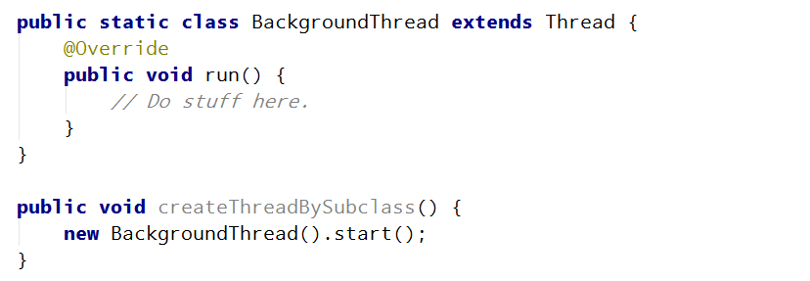
Thread subclassing
Notes:
Traffic is a ‘hyper-local’ issue
Also regional problem
Traffic is a global issue

Slide 7
Thread
Inherits priority
setPriority()
Process.THREAD_PRIORITY_*
Notes:
Traffic is a ‘hyper-local’ issue
Also regional problem
Traffic is a global issue

Slide 8
Controlling threads
Thread.sleep – causes current thread to suspend execution for specified period of time.
Not percise
Sleep can be terminated by interrupts
Thread.interrupt
boolean interrupted()
Clears “interrupted” flag (for current thread), external threads don’t clear flag.
Thread.join
Waits for a completion of another thread
As sleep can be interrupted
Notes:
Traffic is a ‘hyper-local’ issue
Also regional problem
Traffic is a global issue

Slide 9
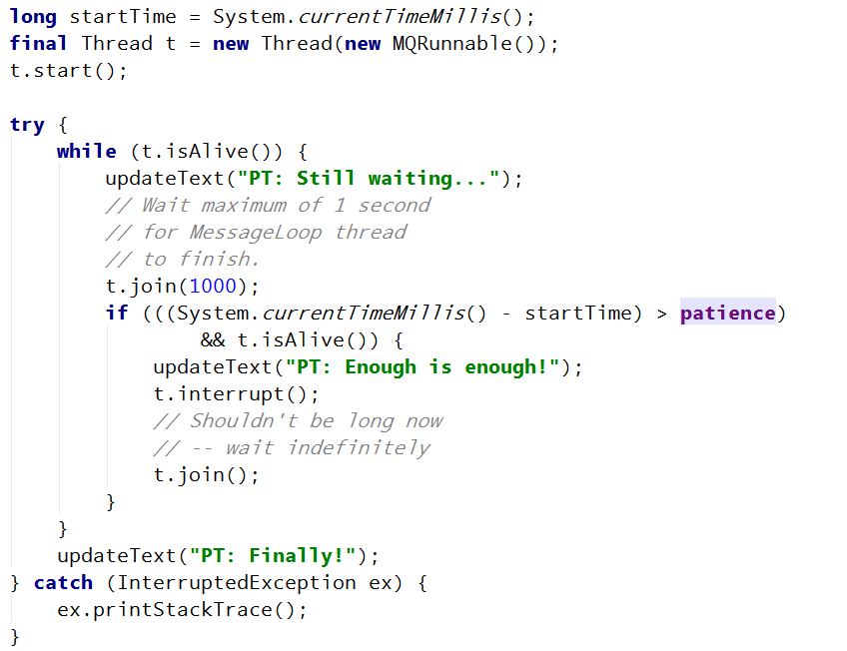
Controlling threads (sample)
Notes:
Traffic is a ‘hyper-local’ issue
Also regional problem
Traffic is a global issue

Slide 10
Threads synchronization
Efficient data sharing between threads
Source of errors:
Thread interference
Memory consistency errors
Synchronization to the rescue
Can cause thread starvation and deadlocks
Immutable objects
Useful in concurrent applications, since they can’t change state, they can’t be corrupted by threads.
Strategy for defining immutable objects
No “setters”
“Sealed” class (can’t override methods)
All fields are private and final. All reference fields are cloned.
Notes:
Traffic is a ‘hyper-local’ issue
Also regional problem
Traffic is a global issue

Slide 11
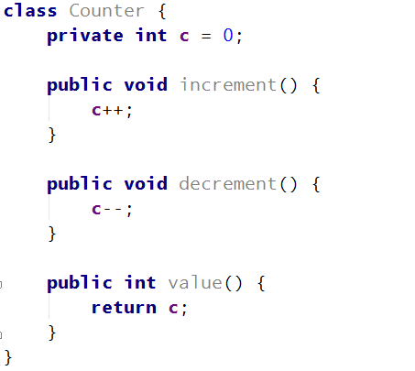
Problem: thread interference
Notes:
Traffic is a ‘hyper-local’ issue
Also regional problem
Traffic is a global issue

Slide 12
Problem: memory consistency
Complex (beyond the scope of this presentations)
Happens-before relationship – guarantee that memory writes by one statement are visible to another statement
http://docs.oracle.com/javase/8/docs/api/java/util/concurrent/package-summary.html#MemoryVisibility
Just know how to avoid them
Notes:
Traffic is a ‘hyper-local’ issue
Also regional problem
Traffic is a global issue

Slide 13
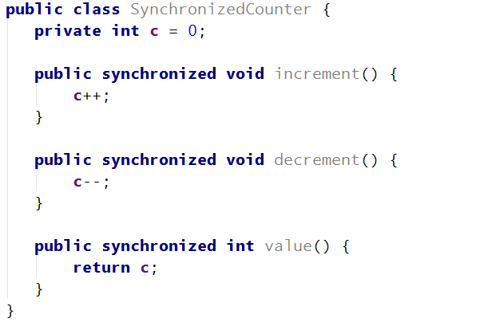
Solution 1 - synchronized
Use synchronized (on methods and statements)
If one thread entered the synchronized method, all other threads will wait (intrinsic lock or monitor)
Synchronized statement establishes “happens-before” relationship
Can lead to thread liveness issues (deadlocks, starvations, etc)
Notes:
Traffic is a ‘hyper-local’ issue
Also regional problem
Traffic is a global issue

Slide 14
Solution 2 – Atomic access
Even a single action can lead to multiple VM instructions
Volatile – reduces the risk of memory consistency issues and establishes the happens-before relationship.
Notes:
Traffic is a ‘hyper-local’ issue
Also regional problem
Traffic is a global issue

Slide 15
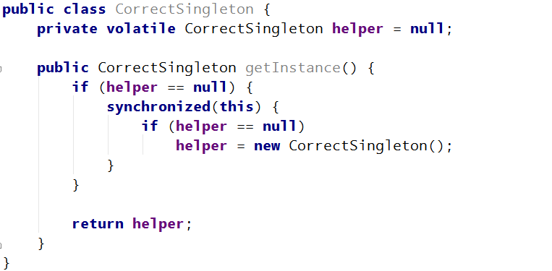
Correct way to implement singleton
http://www.cs.umd.edu/~pugh/java/memoryModel/DoubleCheckedLocking.html
Notes:
Traffic is a ‘hyper-local’ issue
Also regional problem
Traffic is a global issue

Slide 16
Thread liveness
Deadlock
Starvation
Livelock
Notes:
Traffic is a ‘hyper-local’ issue
Also regional problem
Traffic is a global issue

Slide 17
High-level concurrency
Executors
ThreadPoolExecutor
ScheduledThreadPoolExecutor
ExecutorService
Synchronizers and thread pools
CountDownLatch – wait for completion
CyclicBarrier – Map reduce, fork-join processing
Demo
Exchanger – Fill /drain
Concurrent Collections
Demo
NOT Android-related
Java 7 contains ForkJoinPool, implementing work stealing algorithm.
Notes:
Lock interface
Almost same as “synchronized” but more versatile
Can help solving livelock issues
Executor
Use it instead of creating threads manually
Executors factory – use it to create callables, thread pools and various executors
ExecutorService – more flexible than Executor
Thread pool
Used by most of the executors
NOT Android-related
Java 7 contains ForkJoinPool, implementing work stealing algorithm.

Slide 18
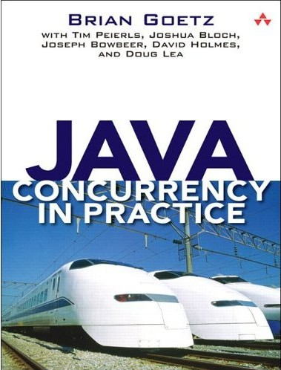
Suggested reading
Java Concurrency in Practice
Notes:
Traffic is a ‘hyper-local’ issue
Also regional problem
Traffic is a global issue

Slide 19
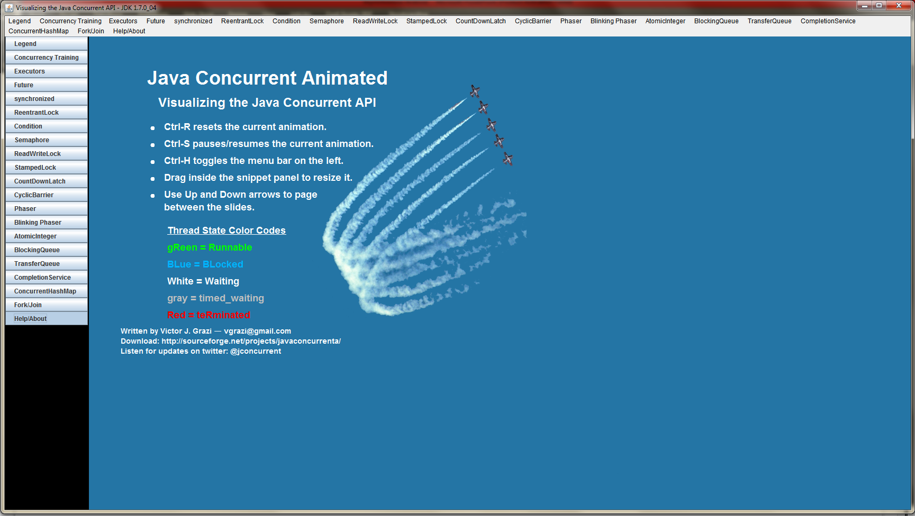
Cool app
http://sourceforge.net/projects/javaconcurrenta/
Notes:
Traffic is a ‘hyper-local’ issue
Also regional problem
Traffic is a global issue

Slide 20
Android-specific concurrency constructs
Async Android

Slide 21
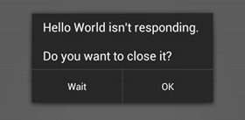
Don’t block UI thread
ANR
Tracking I/O and Network operations on UI thread with StrictMode
Demo
Notes:
Traffic is a ‘hyper-local’ issue
Also regional problem
Traffic is a global issue

Slide 22
Looper and Handler
Looper – turn thread into pipeline thread
Handler
Allows to send and process messages and runnables on the thread’s message queue (MQ)
Bound to the thread (and its MQ) it was created on.
Handler::post, postDelayed, postAtTime
Handler::handleMessage
Handler::obtainMessage
Handler::removeCallbacks, etc.
Handler::postAtFrontOfQueue – do NOT use it, unless you understand the implications
Non-static handler defined inside Activity has a reference to its outer class (Activity) and CAN leak resources.
Notes:
Traffic is a ‘hyper-local’ issue
Also regional problem
Traffic is a global issue

Slide 23
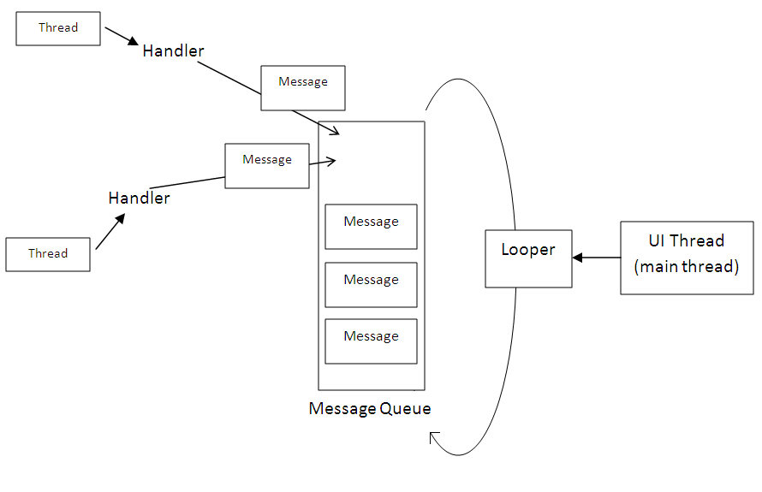
Looper and Handler
Notes:
Traffic is a ‘hyper-local’ issue
Also regional problem
Traffic is a global issue

Slide 24
Looper and Handler
HandlerThread – Creates its own looper, so that handlers can be bound to it.
Tip: Reusing handler
Demo
Notes:
Traffic is a ‘hyper-local’ issue
Also regional problem
Traffic is a global issue

Slide 25
AsyncTask
Wrapper for Handler and Thread
Designed for short-lived background tasks (few seconds)
Convenient:
onPreExecute
doInBackground
onProgressUpdate
onPostExecute
Don’t forget to check for isCancelled
Since the arrival of Honeycomb (Android 3.0, API level 11), multiple AsyncTask instances are executed sequentially by default. If you want to change this behavior, you can have them executed on THREAD_POOL_EXECUTOR by invoking executeOnExecutor.
Demo
Notes:
Traffic is a ‘hyper-local’ issue
Also regional problem
Traffic is a global issue

Slide 26
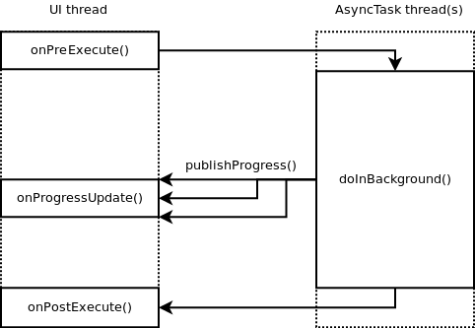
AsyncTask
Notes:
Traffic is a ‘hyper-local’ issue
Also regional problem
Traffic is a global issue

Slide 27
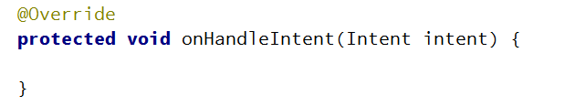
IntentService
Act as any other service in Android
Must be registered in Android Manifest
Pass information with Intent
Handle in onHandleIntent
Demo
Notes:
Traffic is a ‘hyper-local’ issue
Also regional problem
Traffic is a global issue

Slide 28
Loaders
First bullet here
Second bullet here
Notes:
Traffic is a ‘hyper-local’ issue
Also regional problem
Traffic is a global issue

Slide 29
Services and IPC
First bullet here
Second bullet here
Notes:
Traffic is a ‘hyper-local’ issue
Also regional problem
Traffic is a global issue

Slide 30
AlarmManager
First bullet here
Second bullet here
Notes:
Traffic is a ‘hyper-local’ issue
Also regional problem
Traffic is a global issue

Slide 31
Slide title for blank slide (graphics)
Notes:
Traffic is a ‘hyper-local’ issue
Also regional problem
Traffic is a global issue

Slide 32
Slide title here
First bullet here
Second bullet here
Notes:
Traffic is a ‘hyper-local’ issue
Also regional problem
Traffic is a global issue

Slide 33
Section title goes here
Section Subhead

Slide 34
Section title goes here
Section Subhead

Slide 35
Section title goes here
Alternate 1

Slide 36
Section title goes here
Alternate 2

Slide 37
Short content
With bullets
And more bullets

Slide 38
Thank you (or another section slide)

